Slide 1
Enterprise and Distributed Networks
Chapter 11

Slide 2
Learning Objectives
Understand how modems are used in network communications
Understand faster alternatives to modems for network communications
Survey different types of carriers used for long-haul network communications
Explain how larger networks may be implemented using devices such as repeaters, bridges, routers, brouters, gateways, and switches

Slide 3
Modems in Network Communications
Modems convert or MOdulate digital signal from computer into analog signal to be sent on telephone lines
DEModulate analog signal back to digital
See Figure 11-1
May be internal or external
External one has power supply and uses RS-232 serial interface
Include RJ-11 connectors for telephone lines
May be Hayes-compatible

Slide 4
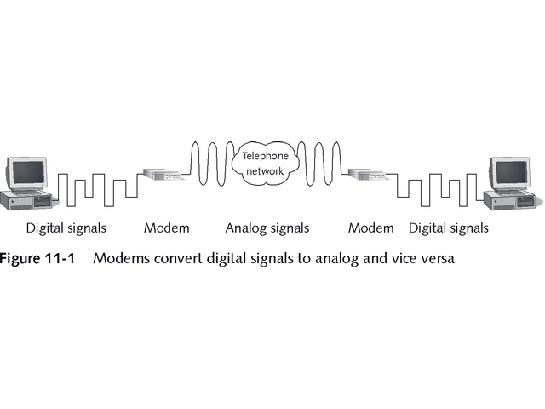
Modems Convert Digital Signals to Analog and Vice Versa

Slide 5
Modem Speed
Measured in bits per second (bps)
V-series standards from International Telecommunications Union (ITU) define speeds, as seen in Tables 11-1
Terms bis (second) and ter (third) indicated revisions
Baud refers to number of oscillations of sound per second
Earlier, baud and bps were interchangeable, but today more than one bit transmits per baud

Slide 6
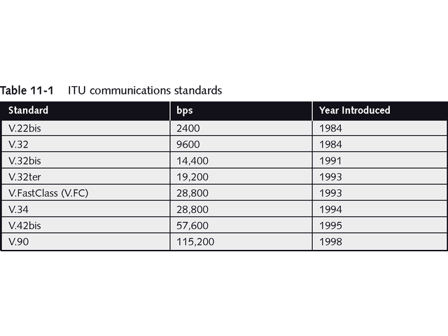
ITU Communication Standards

Slide 7
Types of Modems
Two types of modems
Asynchronous
Synchronous
High-speed digital technologies use special “modems”
DSL modem
Cable modem

Slide 8
Asynchronous Modems
Converts data byte into stream of ones and zeros
Stop and start bits surround each byte, as shown in Figure 11-2
Flow control and data coordination use 25% of bandwidth
May use parity bit for error checking
May compress data for higher transmission speeds
Common method is MNP Class 5 compression

Slide 9
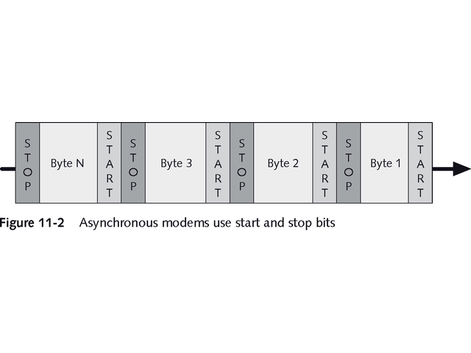
Asynchronous Modems Use Start and Stop Bits

Slide 10
Asynchronous Modems
V.90 is current asynchronous modem standard with connection speeds up to 56 Kbps
Typical Internet connection using V.90 does two-way conversion, as shown in Figure 11-3
Uses pulse code modulation (PCM) to reduce noise, as shown in Figure 11-14
Asymmetric communication uses different download and upload speeds
Limited to 33.6 Kbps from modem to ISP
Achieves 56 Kbps from ISP to modem

Slide 11
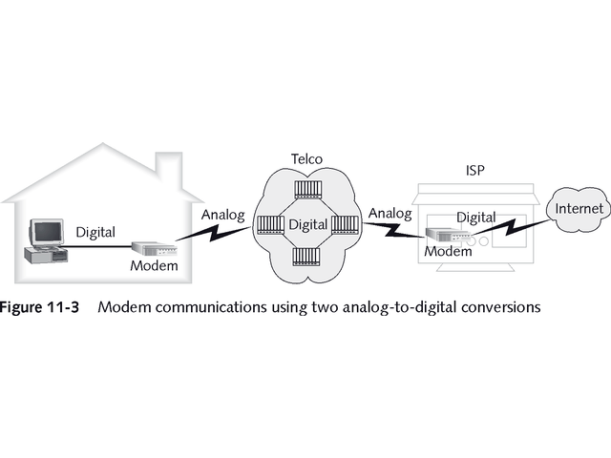
Modem Communications with Two Analog-to-Digital Conversations

Slide 12
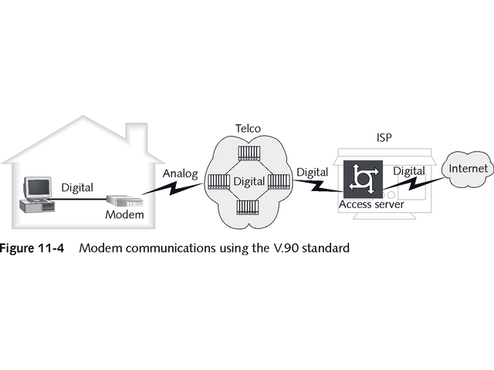
Modem Communications Using V.90 Standard

Slide 13
Synchronous Modems
Use timing to determine where data begins and ends
Use periodic synch bits to synchronize modems
Transmit groups of bits in blocks called frames, as shown in Figure 11-5
Faster than asynchronous modems and provide functions such as error-checking

Slide 14
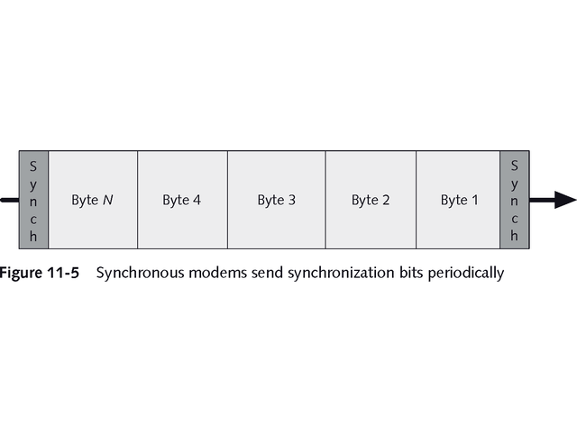
Synchronous Modems Send Synchronization Bits Periodically

Slide 15
Synchronous Modems
Three synchronous protocols
Synchronous Data Link Control (SDLC)
High-level Data Link Control (HDCL)
Binary Synchronous (bisync) Communications
Used on dedicated lease lines

Slide 16
Digital Modems
Term not technically accurate; does not translate from analog to digital
Usually refers to interface for Integrated Services Digital Network (ISDN)
ISDN actually uses two adapters
Network termination (NT) device
Terminal adapter (TA) equipment

Slide 17
Digital Modems
Cable modems use broadband CATV cables and a NIC with RJ-45 connector
Some are analog, but most are digital
Maximum bandwidth is 1.5 Mbps
Use shared access media
Not limited by distance
Strong 56-bit encryption key ensures privacy

Slide 18
Digital Modems
Digital Subscriber Line (DSL) works with regular twisted-pair telephone line
Connections are not shared
Guaranteed bandwidth of least 384-Kbps upstream and downstream
Distance limitations between user and central office (CO), usually between 17,500 feet (3.31 miles) and 23,000 feet (4.36 miles)

Slide 19
Digital Modems
Two varieties of DSL
Asymmetric Digital Subscriber Line (ADSL) with speed up to 8 Mbps download and 1 Mbps upload
Symmetric Digital Subscriber Line (SDSL) with equal upload and download speeds
DSL and cable modems maintain constant connections to remote server

Slide 20
Carriers
Three considerations affect choice of modem and connection for remote network communications
Throughput
Distance
Cost

Slide 21
Carriers
Four carrier options through public switched telephone network (PSTN):
Dial-up
ISDN
DSL
Dedicated leased lines

Slide 22
Carriers
Dial-up is slow, usually limited to 28.8 Kbps
New technology allows up to 56 Kbps over some lines, with experiments up to 115 Kbps
Cost between $18-$35
ISDN offers two options
Basic Rate Interface (BRI) has two 64-Kbps B channels for voice or data and one 16-Kbps D channel for control; cost $50-$70
Primary Rate Interface (PRI) has 23 B-channels and one D channel; cost $300-$600

Slide 23
Carriers
DSL offers 384-Kbps at cost from $30-$60
More expensive 1.5 Mbps upstream/downstream connection may cost between $300-$600
Dedicated leased lines offer higher speeds
Between 56 Kbps and 45 Mbps
Most expensive option

Slide 24
Remote Access Networking
Windows NT uses Remote Access Service (RAS) for dial-up access
Windows 2000 uses Routing and Remote Access Service (RRAS)
Includes local-area routing services
See Figure 11-6
Both serve up to 256 remote clients
Both support virtual private network (VPN) connections over the Internet

Slide 25
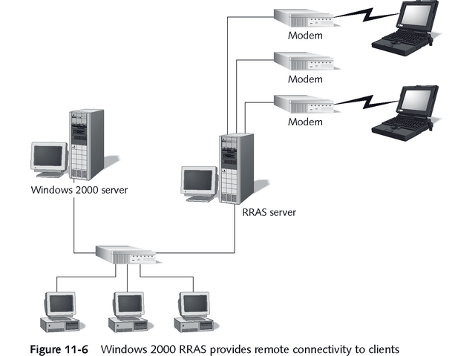
Windows 2000 RRAS

Slide 26
Remote Access Networking
Windows XP, 2000, NT, ME, and 9x include Dial-up Networking (DUN) software
Two protocols for remote access
Serial Line Internet Protocol (SLIP)
Point-to-Point Protocol (PPP)

Slide 27
Serial Line Internet Protocol (SLIP)
Older Physical layer protocol
Connects PC to Internet using modem
No error checking
No compression with standard SLIP
Compressed SLIP (CSLIP) supports compression
Rarely used in today’s environment

Slide 28
Point-to-Point Protocol (PPP)
Provides both Physical and Data Link layer services
Supports multiple protocols, including IP, IPX, and NetBEUI
Supports compression and error checking
Faster and more reliable than SLIP
Supports dynamic IP addressing
Protocol of choice for TCP/IP connections

Slide 29
Creating Larger Networks
Different ways to expand network capabilities
Physically expand to support more computers
Segment to filter and manage network traffic
Extend to connect separate LANs
Connect two or more separate network environments

Slide 30
Creating Larger Networks
Many devices help create larger networks:
Repeaters
Bridges
Routers
Brouters
Gateways
Switches

Slide 31
Repeaters
Attenuation is signal degradation and distortion over distances
Repeaters regenerate signal and extend network’s reach
See Figure 11-7
Packets and Logical Link Control (LLC) protocols must be same on both sides of repeater
Operate at Physical Layer
Do not do filtering or translation

Slide 32
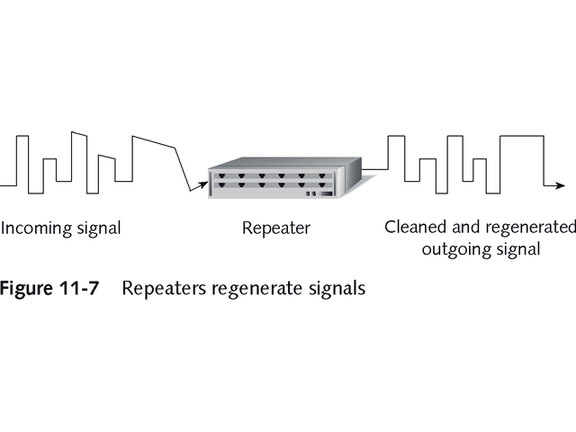
Repeaters Regenerate Signals

Slide 33
Repeaters
Cannot connect different types of networks
Can connect different physical media, as shown in Figure 11-8
Retransmit data at same speed
Slight delay, called propagation delay, during regeneration of signal
Number of repeaters is limited
10Base2 network may have maximum of four repeaters connecting five network segments
Table 11-2 shows advantages and disadvantages of routers

Slide 34
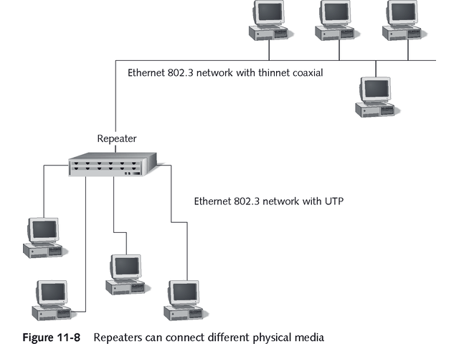
Repeaters Can Connect Different Physical Media

Slide 35
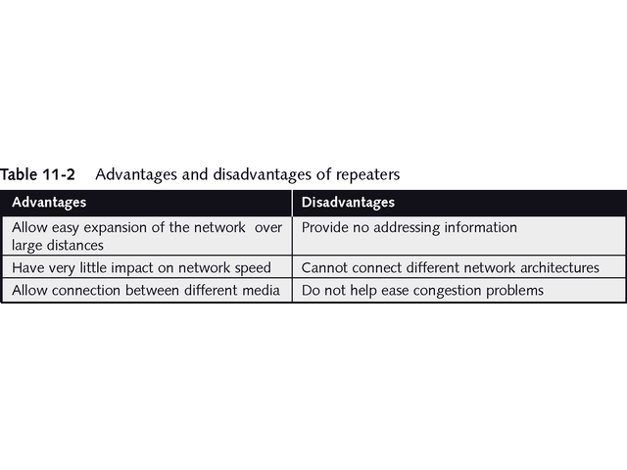
Advantages and Disadvantages of Repeaters

Slide 36
Bridges
Connect two network segments
Can connect different physical media
Limit traffic and eliminate bottlenecks
Can connect different network architectures
Work at Data Link layer
Read MAC addresses to determine whether to forward frame

Slide 37
Bridges
Ethernet networks usually use transparent bridges or learning bridges
They build bridging table as they forward frames
Include source and destination addresses
Use bridging tables to determine whether to forward frames

Slide 38
Bridges
Token-ring networks usually use source-routing bridges
Rely of source of frame to provide path information
Remembers path and uses it for future frames to same destination

Slide 39
Bridges
Do not reduce traffic caused by broadcasts
Too many broadcast frames cause broadcast storm and bog down network
Translation bridges can work at Physical layer; connect different types of networks
Table 11-3 shows advantages and disadvantages of bridges

Slide 40
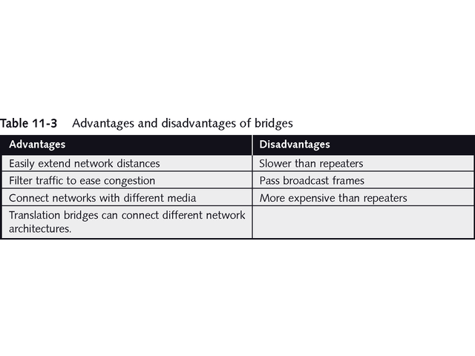
Advantages and Disadvantages of Bridges

Slide 41
Switches
Essentially are high-speed multiport bridges
Maintain switching table of hardware addresses
While bridges connect only two or three network segments, switches may connect hundreds of segments
While bridges perform functions using software, switches use built-in specialized processor

Slide 42
Switches
Use variety of methods to receive frame on one port and forward it on another
Cut-through switching reads only enough of frame to determine where to forward it
Reads only 12-bytes of Ethernet frame
Simplest and fastest method
Disadvantage is forwarding frames with errors

Slide 43
Switches
Store-and-forward switching reads entire frame
Checks it for errors before forwarding it
Detects frame fragments and discards them
Preserves bandwidth, but slows network

Slide 44
Switches
Benefits include ability to dedicate bandwidth to each port
Permit full-duplex communications
Able to segment network into virtual local area networks (VLANs), as seen in Figure 11-9
Each VLAN has unique network number

Slide 45
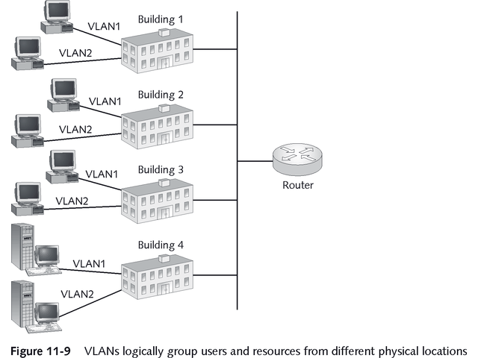
VLANs Group Users and Resources Logically

Slide 46
Routers
Advanced devices able to connect separate networks to form complex internetwork
Each one functions separately
Internet is best-known internetwork
Multiple paths between network segments
Each segment, called a subnetwork, has unique network address
See Figure 11-10

Slide 47
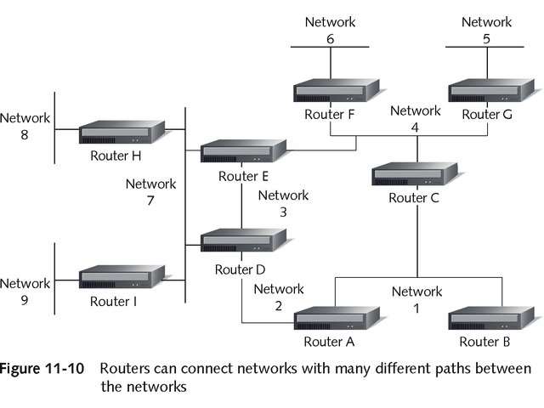
Routers Connect Networks with Many Different Paths Between Them

Slide 48
Routers
Uses destination network address to route packets
Operate at Network layer of OSI model
Use routing tables to select best path
Discard broadcasts and packets with unknown addresses

Slide 49
Routing Tables
Contain network addresses
Based on Figure 11-10, Table 11-4 shows sample routing table
Different types of routers based on way routing tables are populated
Static routing – administrator manually updates routing table
Dynamic routing – uses discovery process to learn about available routes; easier to maintain and provide better route selections

Slide 50
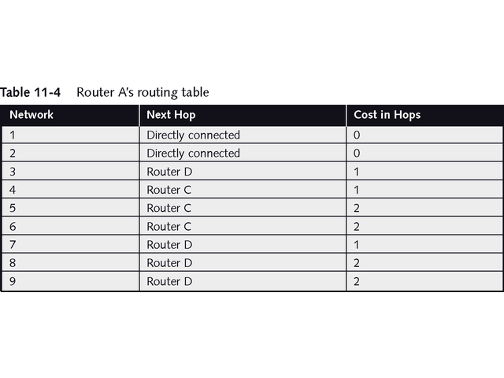
Sample Routing Table

Slide 51
Routers
Use two methods to choose best path for packets
Distance-vector routers use protocols such as Routing Information Protocol (RIP)
Calculates cost based on hop count (number of routers between two networks), bandwidth, network congestion, and delays
Link-state routers use protocols such as Open Shortest Path First (OSPF)
Calculates cost based on speed of links; updates by exchanging entire routing table; requires more processing, but delivers packets more efficiently

Slide 52
Routable versus Nonroutable Protocols
Routable protocols
TCP/IP
IPX/SPX
DECNet
OSI
DDP (AppleTalk)
XNS
Nonroutable Protocols
NetBEUI
DLC (used with HP printers and IBM mainframes)
LAT (Local Area Transport, part of DEC networking structure)
See Table 11-5 for advantages and disadvantages of routers

Slide 53
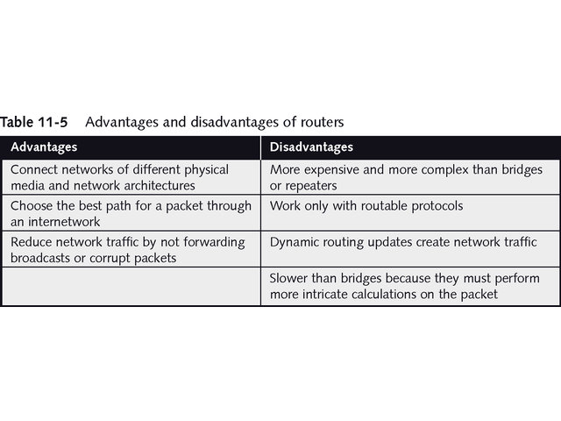
Advantages and Disadvantages of Routers

Slide 54
Brouters
Combine best features of bridges and routers
Choose best path like routers
Forward packets based on hardware address like bridges
Maintain both bridging table of hardware addresses and routing table of network addresses
Useful in hybrid network with mixture of routable and nonroutable protocols
May be identified as router with bridging capabilities

Slide 55
Gateways
Translate between two dissimilar network architectures or data formats
Can change actual format of data
Work at upper layers of OSI model
Use software to strip all networking information from packet; translate data into new format and return to OSI layers
See Figure 11-11
Table 11-6 shows advantages and disadvantages of gateways

Slide 56
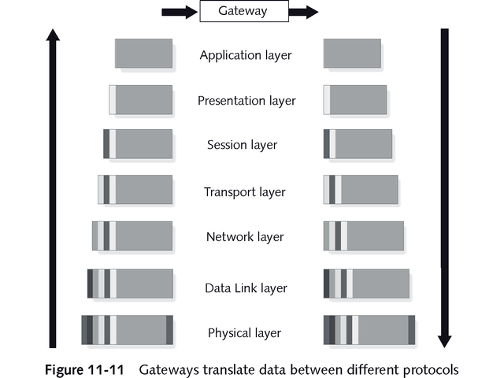
Gateways Translate Data Between Different Protocols

Slide 57
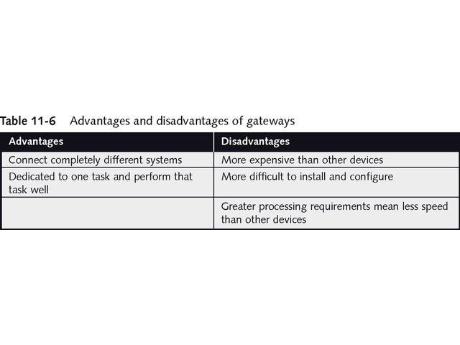
Advantages and Disadvantages of Gateways

Slide 58
Chapter Summary
As network usage increases, it may be necessary to support remote connections to network
Analog modems are simple effective way to provide connectivity to users
Modems can transmit up to 56 Kbps, and speeds are increasing
Remote connects may require greater speeds
ISDN, DSL, cable modem, or dedicated leased-line environments may be best solution

Slide 59
Chapter Summary
ISDN provides dial-up digital network connection up to 128 Kbps from single installation
Cable modems and DSL deliver bandwidth that varies between 384 Kbps and 1.5 Mbps
Leased lines provide continuous point-to-point connectivity between sites and may be best solution for connecting remote office when bandwidth should be higher than 1.5 Mbps

Slide 60
Chapter Summary
Windows NT Server and Windows 2000 Server include support for remote access services, permitting up to 256 users to dial in to server
Repeater increases length of network by eliminating effect of signal attenuation
Bridge installed between two network segments filters traffic according to hardware destination address

Slide 61
Chapter Summary
Placing computers that communicate most often on same side of bridge reduces network traffic
Bridge can connect networks with different physical media, such as 10BaseT and 10Base2
Switches are similar to bridges, but advanced technology allows them to handle more network segments and switch frames much faster than bridges

Slide 62
Chapter Summary
Three primary switching methods are cut-through, store-and-forward, and fragment-free
Router connects several independent networks to form complex internetwork
Able to connect networks with different physical media, a router can also connect networks using same protocols but different architectures, such as Ethernet and token ring

Slide 63
Chapter Summary
In a network with multiple paths, router determines best path for packet to take to reach destination
Using static routes, router sends packet along same path
Using dynamic routing, router makes decision about path to send packet based on cost of packet traveling particular path

Slide 64
Chapter Summary
RIP protocol lets routers learn and advertise paths available to them
RIP is distance-vector protocol that uses number of routers (hops) along path to determine cost
OSPF is link-state routing protocol that determines packet’s best path by taking other factors into account, including line speed and network congestion

Slide 65
Chapter Summary
Brouters incorporate best functions of bridges and routers
Brouters route protocols that have Network layer information and bridge protocols that do not
Gateways are most intricate networking devices
Gateways translate information from one protocol to another and generally operate at upper levels of OSI model

